Slide 1

How I accidentally cost
a client 1700 €
in BigQuery
Beginner lessons to avoid it
Branislav Mateáš | BMateas.com

Slide 2


About me
Flutter programmer of 3+ years before
  Studying IT and Information Science & Librarianship
In my third year of digital analytics
  Incident happened in 2024
  Currently working as an analytics freelancer (No I was not laid off 😃)

Slide 3
“Google Cloud has probably the most complicated UX I have ever seen, and I consider myself pretty technical.”
-one of the CFOs I work with

Slide 4
The invoice arrived before the lesson did
≈ €1,700
1
A broad query worked
2
It was run repeatedly
Unexpected BigQuery charges
3
A dashboard multiplied it
4
The bill made the pattern visible

Slide 5
So how does the BQ pricing actually work?

Slide 6
BIGQUERY PRICING - SIMPLY
BigQuery charges for what it reads*
THE LIBRARY
10
rows returned
Bytes processed = selected columns read
Result size ≠ scan size
You can also reserve BigQuery slots-but that is usually for advanced users and larger marketing teams.
03
Notes:
Use the library analogy. Imagine asking a librarian to find ten lines. If the librarian must read eight shelves to find them, you pay for eight shelves read-not for ten lines copied into your notebook.
With BigQuery on-demand pricing, the main query charge is based on bytes processed. BigQuery is columnar, so selecting fewer columns can reduce what it reads. A tiny result can still require a huge scan. Mention that storage and other pricing models exist, but they are outside today’s beginner story.
[Visual/layout suggestion]
A simple library shelf visual flows into a tiny result sheet. Keep the analogy central and the pricing caveat in notes.
[Sources]
https://cloud.google.com/bigquery/pricing - on-demand pricing is based on bytes processed; LIMIT does not reduce selected-column processing.

Slide 7
BIGQUERY PRICING - TWO BILLS
You pay for storage and searches
STORAGE
QUERIES
Books on the shelves
Librarian reads the shelves
10 GiB active storage free / month
Pay for bytes stored
90 days unmodified → long-term (~50% lower)
Storage is one bill
1 TiB processing free / month
After free tier: ~$6.25 / TiB scanned
Pay for bytes processed
Query processing is another bill
Units: 1 TiB = 1,024 GiB; 1 TB = 1,000 GB. A TiB is about 10% larger than a TB.
03A
Notes:
Use the library analogy, but distinguish the two bills. Storage is the books kept on the shelves. On-demand query processing is the librarian reading shelves during each search.
Standard on-demand beginner figures: the first 1 TiB of query data processed each month is free, then the listed standard price is about $6.25 per TiB scanned. The first 10 GiB of storage each month is free. Prices can vary by region and billing currency.
A table or partition not modified for 90 consecutive days automatically qualifies for the long-term storage rate. This is roughly 50% lower in the common pricing story. Querying does not reset the timer; modifying stored data does.
Keep the takeaway conceptual: there are three levers. Make the library smaller by removing or archiving data you do not need. Make each search smaller by asking for fewer columns or partitions. And be willing to abandon a search when the estimate is clearly too expensive.
[Sources]
https://cloud.google.com/bigquery/pricing
https://docs.cloud.google.com/bigquery/docs/best-practices-costs
https://docs.cloud.google.com/bigquery/docs/custom-quotas

Slide 8
STORAGE BILLING ONLY
Logical or physical? Choose the billing meter
LOGICAL - DEFAULT
PHYSICAL
Bill the uncompressed size
Bill the compressed size
100 GB logical
Pay for 100 GB
Lower rate per GiB
History included
30 GB physical
Pay for 30 GB
≈2× rate per GiB
History billed separately
I usually leave it at default. Query pricing does not change.
03B
Notes:
This choice applies only to storage billing, not to on-demand query pricing. BigQuery stores the same compressed physical data either way; the dataset setting changes only which byte measurement appears on the bill.
Use the example: 100 GB logical versus 30 GB physical. Logical billing charges 100 GB at the lower logical rate. Physical billing charges 30 GB at a per-GiB rate that is roughly twice as high in common regions, so strong compression is required before physical billing wins.
The catch is history. With logical billing, time travel and fail-safe storage are included in the base rate. With physical billing, those historical copies are billed separately at active physical rates. A Dataform model that runs CREATE OR REPLACE TABLE daily can therefore accumulate short-lived historical storage; incremental models that update only recent partitions reduce that risk.
GA4 event exports are often nested, repetitive, append-oriented, and partitioned by day, so physical billing can be a good candidate for the raw dataset-but measure first with INFORMATION_SCHEMA.TABLE_STORAGE. The setting is per dataset, takes about 24 hours to apply, and cannot be changed again for 14 days.
[Sources]
https://docs.cloud.google.com/bigquery/docs/storage_overview
https://docs.cloud.google.com/bigquery/docs/time-travel
https://docs.cloud.google.com/bigquery/docs/information-schema-table-storage

Slide 9
Four ways to change the cost
CHOOSE
1
Make the library smaller
Keep less data in BigQuery when it is no longer useful
2
Ask the librarian to read less
What options do we have?
Select fewer columns
3
Know when to stop
Abandon the search when the estimate is clearly too expensive
4
Don’t rely on memory
Use estimates and hard query limits
Notes:
First, make the library smaller: keep less data in BigQuery when it is no longer useful. Second, ask the librarian to read less: select fewer columns and prune partitions. Third, be impatient and abandon a search when the estimate is clearly too expensive. Finally, larger or more advanced teams can move away from per-byte on-demand pricing and reserve slot capacity instead.
The key transition from the previous slide: storage and searches are the two bills; these are the broad ways to change those bills.
[Sources]
https://cloud.google.com/bigquery/pricing
https://docs.cloud.google.com/bigquery/docs/best-practices-costs

Slide 10
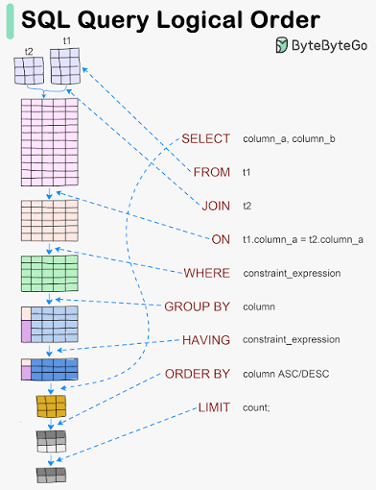
THE DANGEROUS MISCONCEPTION
LIMIT limits the answer-not the reading
SELECT *
FROM `analytics.large_table`
LIMIT 10;
10 rows back
LIMIT is useful for output.
It is not a cost guardrail.
possibly the whole selected table scanned
04
Notes:
This is the beginner trap I fell into: ten rows feels small. But LIMIT controls how many rows BigQuery returns after processing; it does not automatically stop BigQuery reading the selected columns.
Say it twice in different words: a short answer can still require a long search. In the console, look at the estimate before running rather than trusting LIMIT.
[Visual/layout suggestion]
Dark SQL block on the left; green output versus orange scan consequence on the right.
[Sources]
https://cloud.google.com/bigquery/pricing - explicit LIMIT does not change charges for data processed in selected columns.

Slide 11
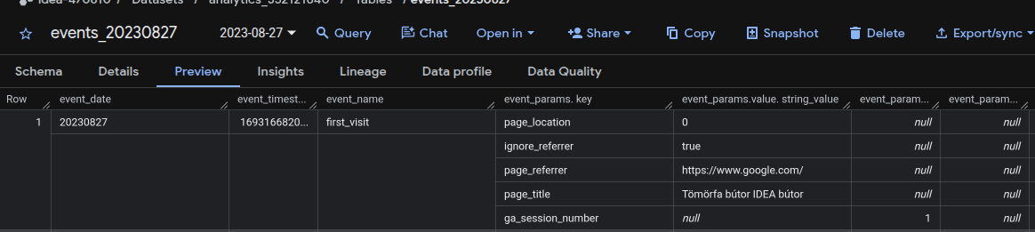
BIGQUERY COST SURVIVAL
First choice: use the Preview tab
Explorer
→ select a table
→ Preview
0 query bytes
See example rows
without writing SQL
Free and does not use query quota. Not available for every table type, including views and external tables.
04A
Notes:
Use Preview when you only need to inspect example rows or understand a table’s shape. In the BigQuery console, expand the project and dataset, select a table, and click the Preview tab. This retrieves table data without running a query, so there is no query charge and it does not consume query quota.
The Preview tab is not available for every table type, including views and external tables. If Preview is unavailable or you need a randomized subset, TABLESAMPLE is the next option.
[Sources]
https://docs.cloud.google.com/bigquery/docs/quickstarts/load-data-console
https://docs.cloud.google.com/bigquery/docs/best-practices-costs

Slide 12
BIGQUERY COST SURVIVAL
A safer first look: TABLESAMPLE
SELECT
event_name, user_pseudo_id
FROM `analytics.events`
TABLESAMPLE SYSTEM (1 PERCENT);
1% of storage blocks
Queries a random sample
from a large table
GA4 events_*: samples storage blocks-not individual events, users, or sessions. Small tables may still be read in full.
04B
Notes:
TABLESAMPLE SYSTEM reads a percentage of storage blocks, not an exact random percentage of rows. It is useful when you are learning a table, checking formats, or validating logic and do not need complete data.
Important nuance: sampling does not make every analysis valid, and BigQuery does not cache TABLESAMPLE results. Use it for exploration, then move to a properly filtered production query.
[Visual/layout suggestion]
Large code example with a single blue 1% block callout.
[Sources]
https://cloud.google.com/bigquery/docs/table-sampling - TABLESAMPLE SYSTEM samples data blocks; sampled query results are not cached.

Slide 13
PARTITIONING 101
Partition one large table into smaller slices
CREATE TABLE `analytics.events_report`
PARTITION BY DATE(event_timestamp)
OPTIONS (partition_expiration_days = 90)
AS SELECT * FROM `analytics.events_raw`;
WHAT CAN DEFINE A PARTITION?
Date: event_date
Timestamp: event_timestamp
Ingestion time: arrival date
Integer range: account_id
01
02
03
04
05
06
07
08
09
10
Read only the dates you need. Expire old partitions automatically.
12
Notes:
GA4’s standard export creates separate date-sharded tables named events_YYYYMMDD, not one table partitioned by date. The wildcard events_* can match many tables; _TABLE_SUFFIX is the portion matched by the wildcard. Filtering it with constant dates makes BigQuery scan only the required daily tables.
If streaming export is enabled, GA4 also creates events_intraday_YYYYMMDD. This is a temporary staging table updated throughout the day and deleted when the stable events_YYYYMMDD daily table is complete. With the events_* wildcard, the suffix of an intraday table begins with intraday_, so the eight-digit BETWEEN filter shown excludes it.
[Sources]
https://docs.cloud.google.com/bigquery/docs/querying-wildcard-tables
https://support.google.com/analytics/answer/7029846
https://support.google.com/analytics/answer/9358801

Slide 14
COST DRIVER #1
SELECT * quietly chooses every column
SELECT *
FROM `idea-470810.analytics_352121640.events_202308*`;
event_date
user_id
event_name
device
geo
items
traffic_source
… 100+ more
Two asterisks, two meanings:
SELECT * = every column
events_202308* = every August 2023 daily table
_TABLE_SUFFIX BETWEEN '01' AND '07' = only August 1 to 7
05
Notes:
Explain the star: it means every column. In a wide raw analytics table, that can include nested ecommerce items, device data, traffic source fields, parameters, and much more. BigQuery stores data by column, so choosing every column asks it to read far more than most questions need.
The incident was not one spectacular query. Repetition was the multiplier: edit, run, inspect, change, run again.
[Visual/layout suggestion]
One SELECT * block points to a widening field of columns. The composition should feel like expansion.
[Sources]
https://cloud.google.com/bigquery/docs/best-practices-performance-compute - project only the columns needed; LIMIT with SELECT * does not control bytes read.

Slide 15
COST DRIVER #2
One Looker Studio refresh can multiply a raw-table scan
Scorecard query
large raw scan
Looker Studio
refreshes a
wide raw table
Chart query
large raw scan
Table query
large raw scan
Filter query
large raw scan
Blended-data query
large raw scan
Measure it: INFORMATION_SCHEMA.JOBS + Looker Studio report and data-source labels
06
Notes:
Walk left to right. A dashboard page is not necessarily one query. Different charts, filters, blends, date changes, viewers, and refreshes can generate multiple BigQuery jobs. If every job hits the same large raw table, the bytes accumulate.
You can measure this instead of guessing. Query the regional INFORMATION_SCHEMA.JOBS view and inspect total_bytes_billed. Looker Studio jobs carry labels including requestor=looker_studio, looker_studio_report_id, and looker_studio_datasource_id, so you can attribute usage to a report or data source.
The fix is usually to put smaller, purpose-built reporting tables between the raw GA4 export and Looker Studio. Build them incrementally with Dataform or scheduled SQL. GA4Dataform can be a useful starter project for analysis-ready GA4 tables, but evaluate and customize it for the use case; the Google Marketing Solutions example is explicitly unsupported, and the similarly named community product is third-party.
[Sources]
https://cloud.google.com/bigquery/docs/bi-engine-looker-studio
https://docs.cloud.google.com/bigquery/docs/information-schema-jobs
https://github.com/google-marketing-solutions/ga4_dataform
https://docs.ga4dataform.com/

Slide 16
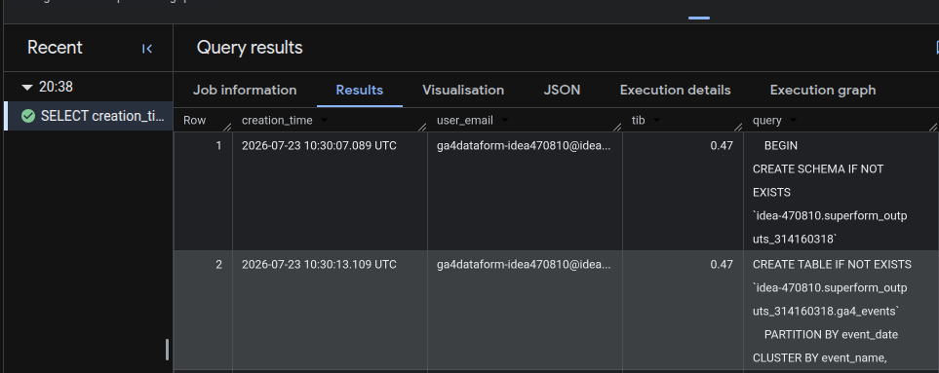
BIGQUERY COST FORENSICS
Find the queries that burned the budget
SELECT creation_time, user_email,
ROUND(total_bytes_billed / POW(1024, 4), 2) AS tib,
query
FROM `region-eu`.INFORMATION_SCHEMA.JOBS_BY_PROJECT
WHERE creation_time >= TIMESTAMP_SUB(
CURRENT_TIMESTAMP(), INTERVAL 180 DAY)
ORDER BY total_bytes_billed DESC
LIMIT 100;
History window
180 days only
06A
Notes:
Use this query to identify the most expensive recent query jobs in a project. Replace region-eu with the job location, for example region-us.
The key limitation is retention: INFORMATION_SCHEMA.JOBS views expose 180 days of job history. Therefore the 2024 incident cannot be reconstructed from this view today unless its data was exported elsewhere.
JOBS_BY_PROJECT requires permission to list all jobs in the project. Use JOBS_BY_USER when only the current user's jobs are available.
[Sources]
https://cloud.google.com/bigquery/docs/information-schema-jobs — JOBS view schema, regional qualification, scope, permissions, and 180-day retention.

Slide 17
THE BETTER ARCHITECTURE
Build reporting tables before dashboard queries
1
2
3
4
Raw GA4 export
Dataform
Reporting tables
Looker Studio
Detailed events
kept as source
Scheduled SQL
transforms + tests
Narrow, aggregated,
partitioned
Fast, controlled
dashboards
Transform once. Serve many times.
14
Notes:
This is the architecture we should have used sooner. Keep the raw GA4 export as the detailed source of truth. Use Dataform-or another transformation workflow-to create narrow, aggregated reporting tables on a schedule. Point Looker Studio at those reporting tables.
The key economic idea is reuse: do the expensive transformation intentionally once, then let many dashboard interactions read a much smaller table. Add tests and ownership so the cost controls survive beyond one analyst.
[Visual/layout suggestion]
Four-stage left-to-right architecture using native shapes: raw export → Dataform → reporting tables → Looker Studio.

Slide 18
GUARDRAIL 1
Read the estimate before Run
This query will process
Pause here
2.4 TB
RUN
Check columns, dates and source
CLI / AI agents:
bq query --dry_run \
'SELECT ...'
Beginner rule of thumb: pause at ≥100 GiB. 1 TiB ≈ $6.25-and repetition multiplies it.
10
Notes:
Point out that the BigQuery editor shows an estimate before execution when it can calculate one. Build a physical habit: eyes go to the estimate before the Run button.
If the number surprises you, stop. Check whether you selected every column, missed a partition/date filter, expanded a wildcard too far, or joined to an unexpectedly large table. Estimates are guardrails, not guarantees for every query shape.
[Visual/layout suggestion]
Mock BigQuery estimate area-generic and intentionally free of project identifiers.
[Sources]
https://cloud.google.com/bigquery/docs/best-practices-costs - preview query costs and use dry runs/estimates before execution.

Slide 19
BIGQUERY COST SURVIVAL
Guardrail 2: give every query a hard ceiling
bq query \
--maximum_bytes_billed=1000000000 \
'SELECT ...'
If the estimate is above 1 GB…
The query fails safely
Especially important when AI agents can generate or run SQL
UI: Edit → Query settings → Advanced options → Maximum bytes billed → Save
11
Notes:
Maximum bytes billed is a seat belt. If BigQuery estimates the query will exceed the ceiling, it refuses to run. Choose a limit appropriate to the task-1 GB here is only an example, not a universal recommendation.
This matters even more with AI-assisted analytics. A model can write plausible SQL very quickly; a billing ceiling turns an accidental broad query into an error rather than an invoice. Pair it with read-only permissions and human review where appropriate.
Configuration concept: in an API query job, set query.maximumBytesBilled to a byte value. In the console, use Query settings → Advanced options → Maximum bytes billed.
[Visual/layout suggestion]
CLI configuration example on the left; safe-failure result on the right; AI warning as a strong bottom message.
[Sources]
https://cloud.google.com/bigquery/docs/best-practices-costs - maximum bytes billed limits query cost and causes queries above the limit to fail.

Slide 20
ADVANCED PERFORMANCE
Approximation saves compute-not bytes scanned
SELECT
APPROX_COUNT_DISTINCT(user_pseudo_id) AS users
FROM `analytics.events`;
HLL++
A compact sketch of
“who was seen”
that can be stored
and merged later
Exact
Approximate
Billing, payouts, compliance,
small reconciliations
APPROX_QUANTILES
APPROX_TOP_COUNT
APPROX_TOP_SUM
Faster and lighter on slots; on-demand pricing still bills the bytes read.
13
Notes:
Approximate aggregate functions trade some accuracy for lower memory use and faster computation. BigQuery provides APPROX_COUNT_DISTINCT, APPROX_QUANTILES, APPROX_TOP_COUNT, and APPROX_TOP_SUM. HLL++ and KLL sketches offer more control and can be stored and merged later.
Important pricing distinction: under on-demand pricing, the scan is still billed from the logical bytes read, so an approximate aggregate does not automatically reduce the query bill. The main benefit is performance and lower computational resource use; that can be especially relevant for capacity-based workloads using slots.
[Sources]
https://docs.cloud.google.com/bigquery/docs/reference/standard-sql/approximate_aggregate_functions
https://docs.cloud.google.com/bigquery/docs/sketches
https://docs.cloud.google.com/bigquery/docs/best-practices-costs

Slide 21
OTHER GOOD PRACTICES
Other ways to reduce cost
1
Filter before joining
Send fewer rows into joins and aggregations.
WHEN SCALE CHANGES
$5k+
2
Pre-aggregate large inputs
Reduce shuffling before expensive joins.
monthly on-demand
compute spend
3
Reuse intermediate results
Materialize transformations that run repeatedly.
Compare slot reservations
Use cached results
Identical SQL on unchanged tables can cost $0.
Measure steady demand first.
Trial before committing.
4
15
Notes:
“Largest table first” means place the largest fact table as the first/left input of the JOIN and the smallest lookup table on the right. It does not mean changing an INNER JOIN into a LEFT JOIN; the join type must follow the required result semantics.
Why it helps: BigQuery can broadcast a sufficiently small right-hand table to the workers already processing the large table. This can avoid a more expensive shuffle of both inputs. The optimizer often chooses the plan itself, but explicit ordering remains Google's recommended pattern. Filtering or pre-aggregating before the join can matter even more.
BigQuery cached results are best-effort and typically live for about 24 hours. A cache hit bills zero query bytes, but it generally requires identical query text and unchanged source tables. Cache can be invalidated sooner and does not apply in several cases, including wildcard-table queries, recent streaming inserts, destination tables, or nondeterministic functions.
For dashboards and pipelines, align refresh frequency with actual data updates. Treat caching as a free bonus, not as a cost-control guarantee: BI tools may issue multiple or slightly different SQL statements.
[Sources]
https://cloud.google.com/bigquery/docs/best-practices-performance-compute — join ordering, broadcast joins, and reducing data before JOIN.
https://cloud.google.com/bigquery/docs/cached-results — cache lifetime, zero query charge on cache hits, requirements, and exceptions.

Slide 22
TAKE THIS WITH YOU
BigQuery cost survival checklist
✓
Select only the columns you need
✓
Dry-run and read the estimate
✓
Preview first; sample if needed
✓
Set maximum bytes billed
✓
Filter GA4 table suffixes
✓
Serve dashboards smaller tables
Then verify: measure Looker Studio jobs in INFORMATION_SCHEMA.JOBS
16
Notes:
Close by reading the six rules quickly. Add a seventh verbally: watch query history and billing trends, because prevention includes feedback.
Resolve the opening: the €1,700 bill was painful, but the mistake became useful once it changed the system-not just my memory.
Then invite discussion with the exact prompt on the slide. Encourage people to anonymize their examples. If time is short, ask for one story and one guardrail the room would add.
[Visual/layout suggestion]
Two-column checklist with generous spacing; finish on a large discussion question rather than a generic thank-you.
[Sources]
https://cloud.google.com/bigquery/docs/best-practices-costs - official cost-control practices summarized throughout the checklist.

Slide 23
Thank you for your attention!
What is the most expensive BigQuery mistake you have seen or made? Or do you have another optimization tip I did not mention?

