Slide 1

KPIs for AI (Search) Optimization - How to define success?
Branislav Mateáš | bmateas.com
Notes:
Add here that I am originally programmer that switched after 3 years to digital analytics and now more marketing and business side.

Slide 2
But why even care?
It's actually a very relevant question!

Slide 3
The current state of AI traffic
“People on LinkedIn say it's like 1%” - Spoiler: It is even worse!
Case study #1 (B2C e-commerce):
  Well established, 5-10+ years
  Zero-focus on AI and SEO optimization
  Central-european market (over 4+ countries)
  0.015% - 0.001% of the total traffic
  20-40 referrals from AI per month per market
  5-15 AI Overviews mention per month per market

Slide 4
So why optimize?
Case study #2 (B2C + minor B2B SAAS):
  Well established, 25+ years of existence
  Below average SEO up to recently
  Strong EEAT in photography
  Product web
    0.008% of AI traffic
    <10 AIO mentions
  Magazines
    0.2%-1.2% of AI traffic (EN performs better)
      70+ sessions from AI
    Around 150 AIO mentions over every mutation per month

Slide 5
AI is still not a traffic channel…

Slide 6
But: AI Overviews Are Eating Your Clicks
Ahrefs study — 300K keywords, Dec 2025 GSC data
CTR impact by SERP position
-58%
Position 1
-58%
Position 2
-51%
Position 3
-46%
Position 5
-33%
CTR reduction at Position #1
when AI Overview is present
Position 10
-19%
For every 100 clicks you earned historically, Google now keeps 58. Search is becoming zero-click.
Notes:
The question is, how much do we trust GSC nowadays

Slide 7
Losing Organic Visibility = Losing AI Citations
Lily Ray analysis — 11 sites hit by Google Jan 2026 algorithm update
Average drop between 5-51% in the organic
There seems to be a big correlation between organic and the amount of AIO mentions.
11/11
-22.5%
-27.8%
-23.8%
+growth
sites lost
AI citations
avg AI citation
drop
ChatGPT
citation drop
Google AI Mode
drop
Perplexity
(Brave Search pipeline)
Notes:
Therefore you should not invest in strategies that harm your organic traffic.

Slide 8
Losing Organic Visibility = Losing AI Citations
Lily Ray analysis — 11 sites hit by Google Jan 2026 algorithm update
How do LLMs differ?
Google AI Mode
Strongest
ChatGPT
Strong
Tightly coupled to live SERP rankings — steepest declines when organic drops.
Non-Google product, yet declines mirror Google organic drops — scrapes Google index.
Gemini
Moderate
Perplexity
Diverges
Google product but draws from broader/cached knowledge — more moderate declines.
Brave Search pipeline. 7 of 11 sites showed citation GROWTH despite organic drops.
Notes:
Therefore you should not invest in strategies that harm your organic traffic.

Slide 9
Your organic SEO strategy IS your AI visibility strategy.
But how do we measure it?

Slide 10
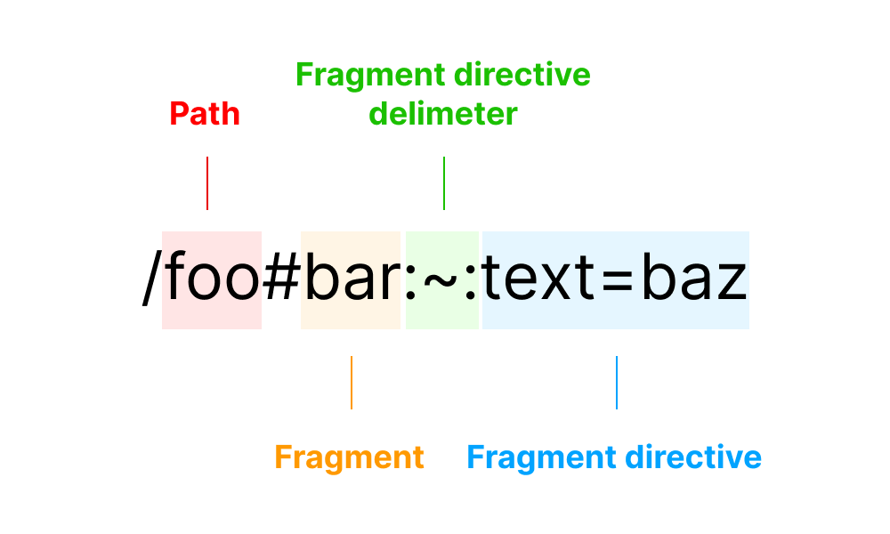
Part 1: Technical Perspective - GTM
Tracking AI Overviews
https://mareklecian.cz/en/ga4-guide-google-ai-overviews-and-ai-mode-measurement/
Beware of WCV!
Notes:
Practical implications - more iterative approach and how I´ve done custom blog posts generation.

Slide 11
Part 1: Technical Perspective - GA4
CHECK 1 — Unassigned Traffic
CHECK 2 — Key Events & Conversion Rate
Where to look:
Where to look:
Reports > Acquisition > Traffic Acquisition
Channel = Unassigned
Reports > Engagement > Key Events
Conversions > All events
Rule of thumb: > 10% unassigned = fix before any reporting
Rule of thumb: sanity-check CR on new landing pages before scaling spend
Takes 5 minutes. Saves you 5 months of wrong results.

Slide 12
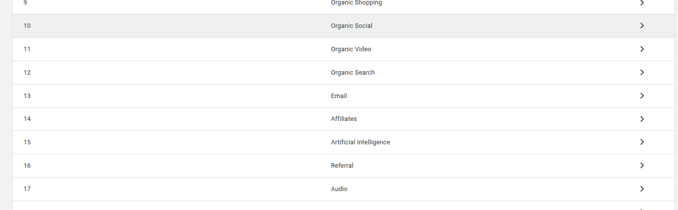
Part 1: Technical Perspective - GA4
https://www.analyticsmania.com/post/ai-traffic-in-google-analytics-4/
A.k.a adding new channel group called Artificial Intelligence

Slide 13
Wonderful AI regex
chatgpt\.com|chat\.openai\.com|gemini\.google\.com|deepseek\.com|perplexity(?:\.ai)?|claude\.ai|copilot\.microsoft\.com|character\.ai|(?:\w+\.)?meta\.ai|grok\.x\.com|grok\.com|x\.ai|bard\.google\.com|(?:\w+\.)?mistral\.ai|writesonic\.com|quillbot\.com|chat\.suno\.com|turing\.microsoft\.com|cosmos\.microsoft\.com|orca\.microsoft\.com|phi\.microsoft\.com|megatron\.microsoft\.com|jarvis\.microsoft\.com|maia\.microsoft\.com|aitastic\.app|bnngpt\.com|chat-gpt\.org|(?:\w+\.)?edgepilot|firefly\.adobe\.com|edgeservices|iask\.ai|(?:\w+\.)?neeva|nimble\.ai|open-assistant\.io|(?:\w+\.)?copy\.ai|openchat\.so|blackbox\.ai|ex\.ai|cohere\.ai|anthropic\.com|(?:\w+\.)?palm-ai\.google\.com|chatglm\.cn|gemini-api\.google\.com|palm\.google\.com|deeplearning\.google\.com|vertexai\.google\.com|ai\.google\.com|deepmind\.google\.com|ml\.googleapis\.com|tensor\.google\.com|t5\.google\.com|my-ai\.snapchat\.com|ai\.baidu\.com|xiaoice\.com|anthropic-api\.com|huggingchat\.com|deepmind\.com|alphacode\.google\.com|copilot\.azure\.com|felo\.ai|chat\.qwen\.ai|(?:\w+\.)?qwenlm\.ai|(?:\w+\.)?outlier\.ai|chat\.hotmart\.ai|customgpt\.ai|venice\.ai|bot\.ivy\.ai|chat\.chatbotapp\.ai|lmarena\.ai|wrtn\.ai|chat\.chaton\.ai|app\.chatboxapp\.ai|duck\.ai|sider\.ai|webpilot\.ai|ai21\.com|pi\.ai|zhipu\.ai|huggingface\.co|wordtune\.com|reka\.ai|synthesia\.io|jasper\.ai|uminal\.org|ai-coustics\.com|magical\.team|vicuna\.ai|floydhub\.com|forefront\.ai|komo\.ai|wav\.ai|d-id\.com|sap\.ai|useblackbox\.io|you\.com|chinchilla\.ai|openrouter\.ai|waldo\.ai|coze\.com|exa\.ai|spellbook\.rossintelligence\.com|yiyan\.baidu\.com|lighton\.ai|baichuan-ai\.com|hyperwriteai\.com|phind\.com|app\.loora\.ai|poe\.com|consensus\.app|andi\.ai|getmerlin\.in|khanmigo\.ai|ora\.sh|socratic\.org|genspark\.ai|searchgpt\.com|operator\.chatgpt\.com
Notes:
I could get your emails but I am too grateful that you guys came here today.

Slide 14
So what are the actual KPIs?

Slide 15
Part 2: Business Perspective
TIER 1
TIER 2
TIER 3
Primary OKRs
Growth KRs
Monitoring
"Are we growing?"
"Why (or why not)?"
"Early warnings?"
Organic Users
Organic Conversions
Rankings · CTR · Content coverage · Technical health
AI citation rates
GSC anomalies · Crawl signals

Slide 16
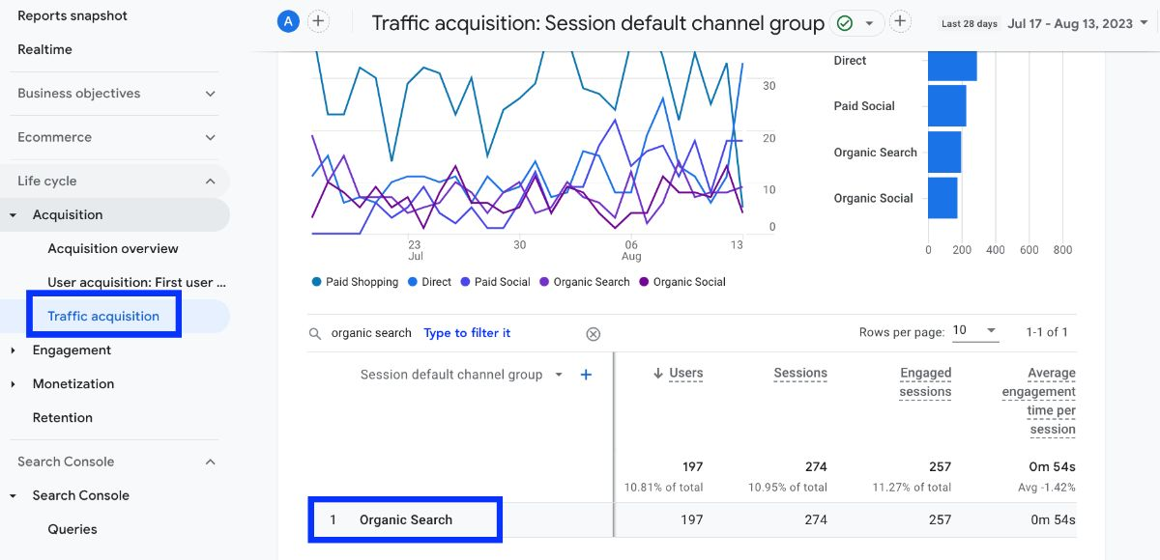
Part 2: Business Perspective - Primary OKRs
"Are we growing?"
Organic Users (GA4/BQ)
Organic Conversions - slightly less valuable than OU in my opinion
CR must not drop as
the traffic grows!

Slide 17
Part 2: Business Perspective - Growth Key Results
Content KRs
"Why (or why not) are we growing?"
Typically checked quarterly
Keyword analysis as a pillar
Affiliate posts
Thinking as an ecosystem
KW coverage %
% of target KW pool with ranking URL
Topic cluster completion
Pillar + supporting pages per cluster
New / optimised URLs / Q
Min. 20/Q — output accountability
E-E-A-T on new content
Author, citation, expert review.
Knowledge base depth
30 terms ranking
Technical: Core Web Vitals (100% green) · Index Coverage (>= 95%).

Slide 18
Part 2: Business Perspective - Growth Key Results
"Why (or why not)?"
Typically checked quarterly
Keyword analysis again
Bing Webmaster tools, GSC data, Ahrefs, Marketing Miner, Semrush...
Ranking KRs
Total KW in Top 10
Y1
Y1
Y2
+30-40%
+30-50%
+70-120%
Priority KW in Top 10
Y1
Y2
>= 60%
>= 90%
Featured Snippets
Y1
Y2
10+
50+
CTR — Track, don't target
AI Overviews + new content additions independently deflate CTR. Use as context, not hard KR.
Technical: Core Web Vitals (100% green) · Index Coverage (>= 95%).

Slide 19
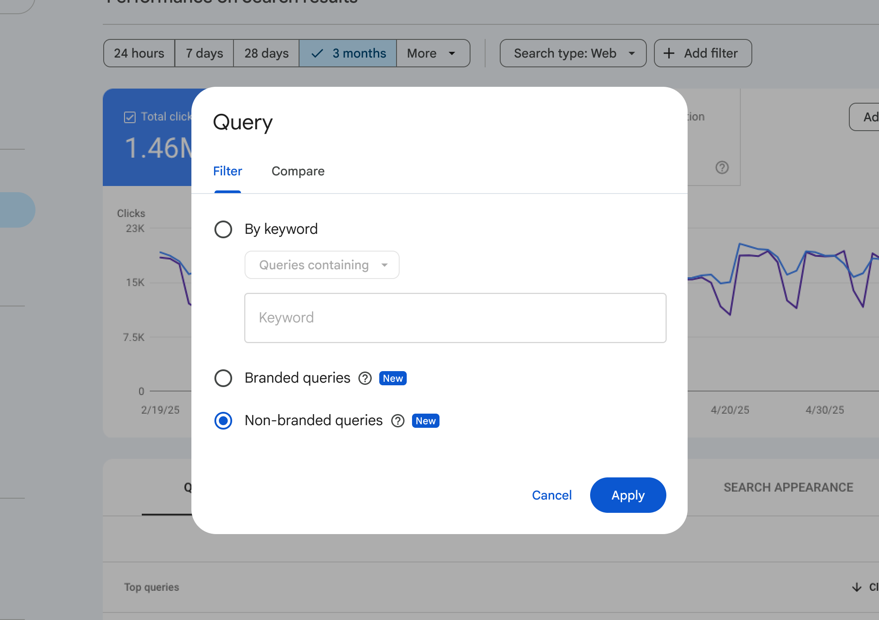

Slide 20
Part 2: Business Perspective - Monitoring
Diagnostic layer: citation rate = cites per AI answer, per platform
ChatGPT
Google AI Mode
Perplexity
Gemini
Benchmark
Benchmark
Benchmark
Benchmark
>= 2.0
1.1-1.5
1.5-2.0
Trending down
citations/answer
citations/answer
citations/answer
vs baseline
Generous. 31% URLs hit 2.0+ but capture 59% of cites. Listicles dominate.
Conservative. 90%+ URLs score <1.0. Prefers brand product/category pages.
Extreme. 64% URLs never cited. Brave Search pipeline. Track separately.
Broader/cached knowledge. Moderate declines vs AI Mode on organic drops.
Prompt intent matters for citation rate
Warning signals
Informational + commercial intent -> ~10-11% of URLs capture 37% of all citations.
Transactional + navigational -> distributed across many sources.
Prioritise BOFU & comparison content for max AI visibility ROI.
- Organic grows, citations don't -> E-E-A-T gap
- AI impressions up but no traffic -> new intent type
- Citations drop across all platforms -> organic problem
Sources: Peec AI study (1M+ citations, Feb 2026) · Lily Ray / Amsive (Feb 2026)

Slide 21
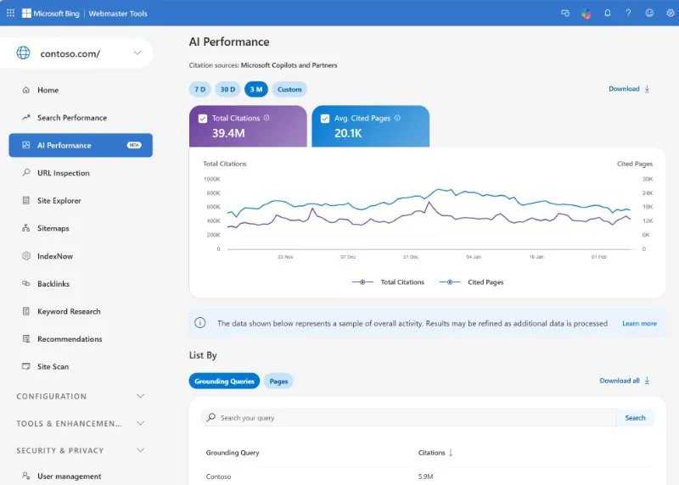
Secondary metrics
% Share of organic traffic
Bing Webmaster Tools -> AI performance
Notes:
I could get your emails but I am too grateful that you guys came here today.

Slide 22
Summary:
3 practical tips from me

Slide 23
1) Keyword analysis should become key part of your AIO strategy

Slide 24
2) Affiliate posts are more important than ever

Slide 25
3) Think of your site more in the terms of branding and ecosystem
A.K.A find your EEAT and embrace it!

Slide 26
Any questions or opinions?
Thank you for your attention!
Branislav Mateáš | bmateas.com

